Slide 1

APEX INSTITUTE OF TECHNOLOGY
DEPARTMENT OF COMPUTER SCIENCE & ENGINEERING
Statistics for Data Science(23CSH-233)
Faculty: Prof. (Dr.) Madan Lal Saini(E13485)
Inferential Statistics
DISCOVER . LEARN . EMPOWER

Slide 2
Statistics for Data Science : Course Objectives
COURSE OBJECTIVES
The Course aims to:
To equip students with the skills to summarize and interpret data using descriptive statistics and visualization techniques.
To develop a foundational understanding of probability and its applications in data science.
To enable students to perform hypothesis testing and construct confidence intervals for statistical inference.
To teach students how to build and assess linear and logistic regression models for predictive analysis.
To provide hands-on experience with statistical software for data manipulation, analysis, and visualization.

Slide 3
COURSE OUTCOMES
On completion of this course, the students shall be able to:-
CO1 | Summarize and describe the main features of a dataset using measures such as mean, median, mode, variance, and standard deviation, as well as graphical representations like histograms, box plots, and scatter plots.
CO2 | Understand of probability theory, including concepts such as random variables, probability distributions, and the law of large numbers, enabling them to model and reason about uncertainty in data.
CO3 | Apply/perform statistical inference, including hypothesis testing, confidence interval estimation, and p-value computation, to draw valid conclusions from sample data about larger populations.
CO4 | Apply linear and logistic regression techniques to identify relationships between variables, make predictions, and evaluate model performance.
CO5 | Utilize statistical software tools to perform data analysis, including data cleaning, transformation, visualization, and implementing various statistical methods.

Slide 4
Unit-3 Syllabus
Unit-3 | Inferential Statistics
Inferential Statistics & Hypothesis Testing | Statistical Inference Terminology, Hypothesis Testing, Parametric Tests, Non-parametric Tests
Industry Application | Hypothesis Testing using Excel Industry Practices & Applications of Statistics

Slide 5
SUGGESTIVE READINGS
TEXT BOOKS:
T1. Hastie, Trevor, et al., The elements of statistical learning. Vol. 2. No. 1. New York: Publisher: Springer, Edition: Second Edition (2009), ISBN: 978-0387848570
T2. Montgomery, Douglas C., and George C. Runger. Applied statistics and probability for engineers. John Wiley & Sons, 2010.
T3. Probability and Statistics The Science of Uncertainty Second Ed., Michael J. Evans and Jeffrey S. Rosenthal.
REFERENCE BOOKS:
R1. Practical Statistics for Data Scientists: 50 Essential Concepts, Authors: Peter Bruce, et al, Publisher: O'Reilly Media, Edition: Second Edition (2020), ISBN: 978-1492072942
R2. An Introduction to Statistical Learning: with Applications in R, Authors: Gareth James, et al, Publisher: Springer, Edition: Second Edition (2021), ISBN: 978-1071614174
R3. Think Stats: Exploratory Data Analysis in Python, Author: Allen B. Downey, Publisher: O'Reilly Media, Publication Year: 2014 (2nd Edition), ISBN: 978-1491907337

Slide 6
Hypothesis Testing: Excel
Instructions

Slide 7
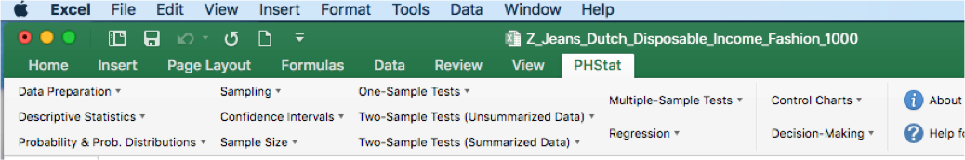




Activate the PHSTAT Plug-in (instructions shown in separate video)
Open the file Z_Jeans_Dutch_Disposable_Income_Fashion_1000.xlsx
Locate the PHSTAT 4 folder (unzipped) on your computer
Click the PHSTAT.XLAM file
Click ‘Enable Macros’ when prompted
PHSTAT Menu will appear on your Excel Spreadsheet

Slide 8
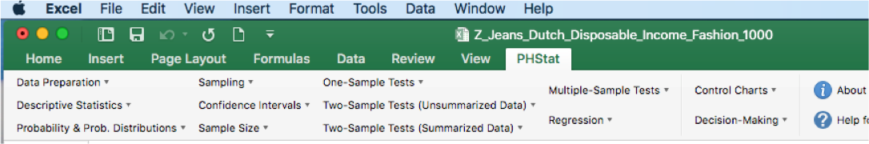

5 ) Click PHSTAT > One Sample Tests > t-test for the mean sigma unknown

Slide 9

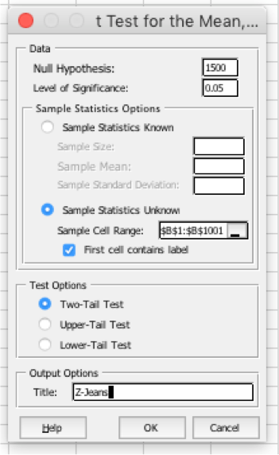















6) Enter the appropriate values in the dialog box
Hypothesized population mean !
Significance Level 𝛂
Select the sample from the appropriate range in the worksheet
Select the appropriate test

Slide 10



















7) A new Worksheet ‘Hypothesis’ will contain the following output
Z-Jeans
Data
Hypothesized population mean !
Null Hypothesis
μ=
1500
Level of Significance
0.05
Significance Level 𝛂
Sample Size
1000
Sample Mean
1584.87
Sample Standard Deviation 756.5145619
Intermediate Calculations
Standard Error of the Mean 23.9231 Degrees of Freedom 999
t Test Statistic 3.5475
^{𝑍}𝑡𝑒𝑠𝑡
Two-Tail Test
Lower Critical Value
-1.9623
Upper Critical Value
1.9623
P-value
p -Value
0.0004
Reject the null hypothesis
Statistical Decision
Make sure to translate the statistical decision to a business decision !!!

Slide 11
References
Books:
Hastie, Trevor, et al., The elements of statistical learning. Vol. 2. No. 1. New York: Publisher: Springer, Edition: Second Edition (2009), ISBN: 978-0387848570
Practical Statistics for Data Scientists: 50 Essential Concepts, Authors: Peter Bruce, et al, Publisher: O'Reilly Media, Edition: Second Edition (2020), ISBN: 978-1492072942
Research Papers:
Garg, Ram and Goyal, Ruchi, Inferential Statistics As a Measure of Judging the Short-Term Solvency An Empirical Study of Three Steel Companies in India (February 5, 2019). International Journal of Advanced Studies of Scientific Research, Vol. 4, No. 1, 2019, Available at SSRN: https://ssrn.com/abstract=3329388.
Alacaci, C. (2004). Inferential Statistics: Understanding Expert Knowledge and its Implications for Statistics Education. Journal of Statistics Education, 12(2). https://doi.org/10.1080/10691898.2004.11910737
Websites:
https://www.simplilearn.com/inferential-statistics-article/
https://builtin.com/data-science/inferential-statistics#:~:text=Inferential%20statistics%20is%20the%20practice,sample%20data%20sample%20or%20population./
Videos:
https://www.youtube.com/watch?v=cjTgyRUaD1s&list=PLbRMhDVUMngeD_vOeveVE-3b7wu_AZph9
https://www.youtube.com/watch?v=ZmCBF5JXOPM&list=PLFW6lRTa1g80s2MWqXNg2o0haq1k14v2I

Slide 12
THANK YOU
For queries
Email: madan.e13485@cumail.in

